Slide 1


NEXT GEN EMPLOYABILITY PROGRAM
CREATING A FUTURE-READY WORKFORCE
Student Name :
NITHIN V
Student ID :
College Name :
STU678f6e3ac45e61737453114
GLOBAL ACADEMY OF TECHNOLOGY

Slide 2
CAPSTONE PROJECT SHOWCASE
Project Title
A Service for Delivering Food (Zomato Clone) with MERN Technology
Abstract | Problem Statement | Project Overview | Proposed Solution | Technology Used | Modelling & Results | Conclusion | Q&A

Slide 3
Abstract
1
The project is a Food Delivery System designed to streamline the process of ordering and delivering food.
2
It consists of a React-based frontend and admin panel, with a Node.js and MongoDB backend.
3
Key features include user authentication, order management, payment integration, and real-time updates.
4
The solution is scalable, secure, and efficient, catering to both customers and restaurant managers.

Slide 4


Problem Statement
Traditional food delivery systems often lack:
Efficient real-time tracking
Seamless payment integration
User-friendly administration tools
Manual order processing leads to:
Delays and errors
Poor user experience
This project addresses these challenges by building a modern, scalable food delivery platform that enhances speed, accuracy, and customer satisfaction

Slide 5

Project Overview
Full-stack web application for food delivery.
Users can:
Browse menus.
Place orders.
Make payments securely.
Admin Panel for Restaurants:
Manage orders.
Update menus.
Analyze sales and performance.
Secure Backend: Handles transactions, data storage, and authentication.
Responsive & Intuitive UI: Enhances user experience.

Slide 6
Proposed Solution
User-Friendly Interface: Built with React for seamless navigation.
Secure Backend: Developed with Node.js & Express.js, using MongoDB for data storage.
Authentication & Security: Uses JWT authentication & bcrypt encryption.
Payment Integration: Implements Stripe for secure transactions.
File Uploads: Uses Multer for high-quality image and document uploads.
Real-Time Order Updates: Keeps users and restaurants informed.
Admin Dashboard: Provides an analytics dashboard for revenue and order trends.

Slide 7
Technology used
Frontend: React.js, React Router, Axios, Vite
Backend: Node.js, Express.js, MongoDB, Mongoose
Security: JWT, Bcrypt, CORS
Payment Processing: Stripe
File Uploads: Multer
Deployment: Docker, AWS, Firebase (for authentication and notifications)

Slide 8
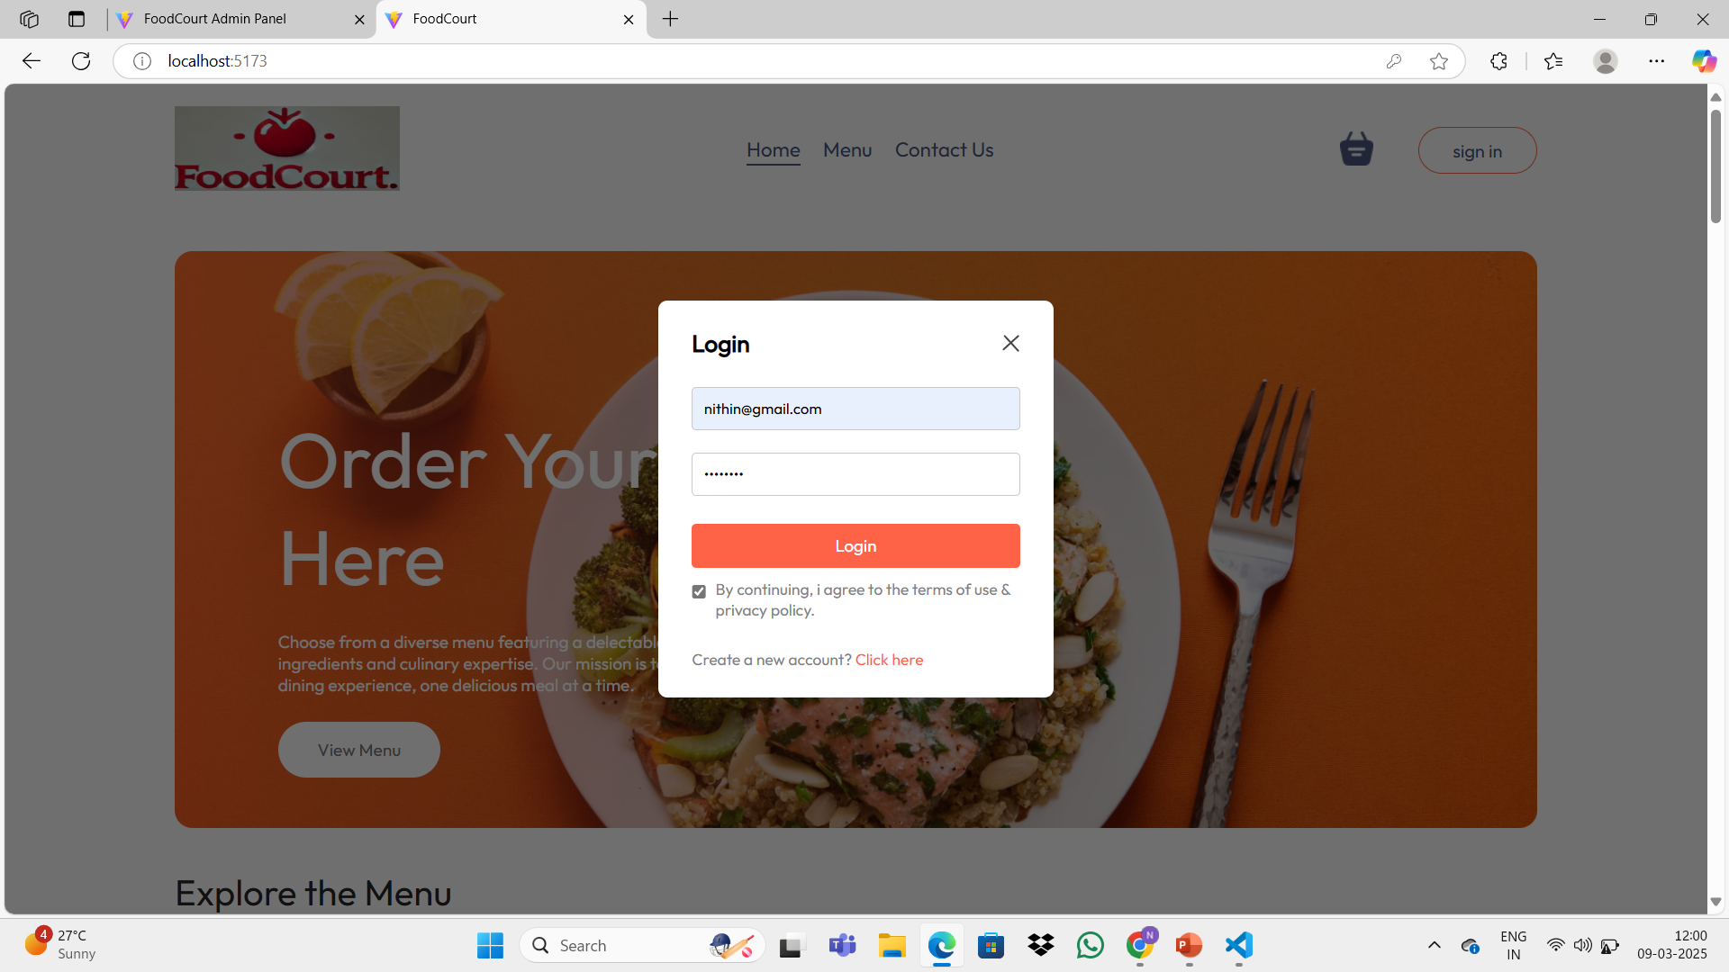
Modelling & Result

Slide 9
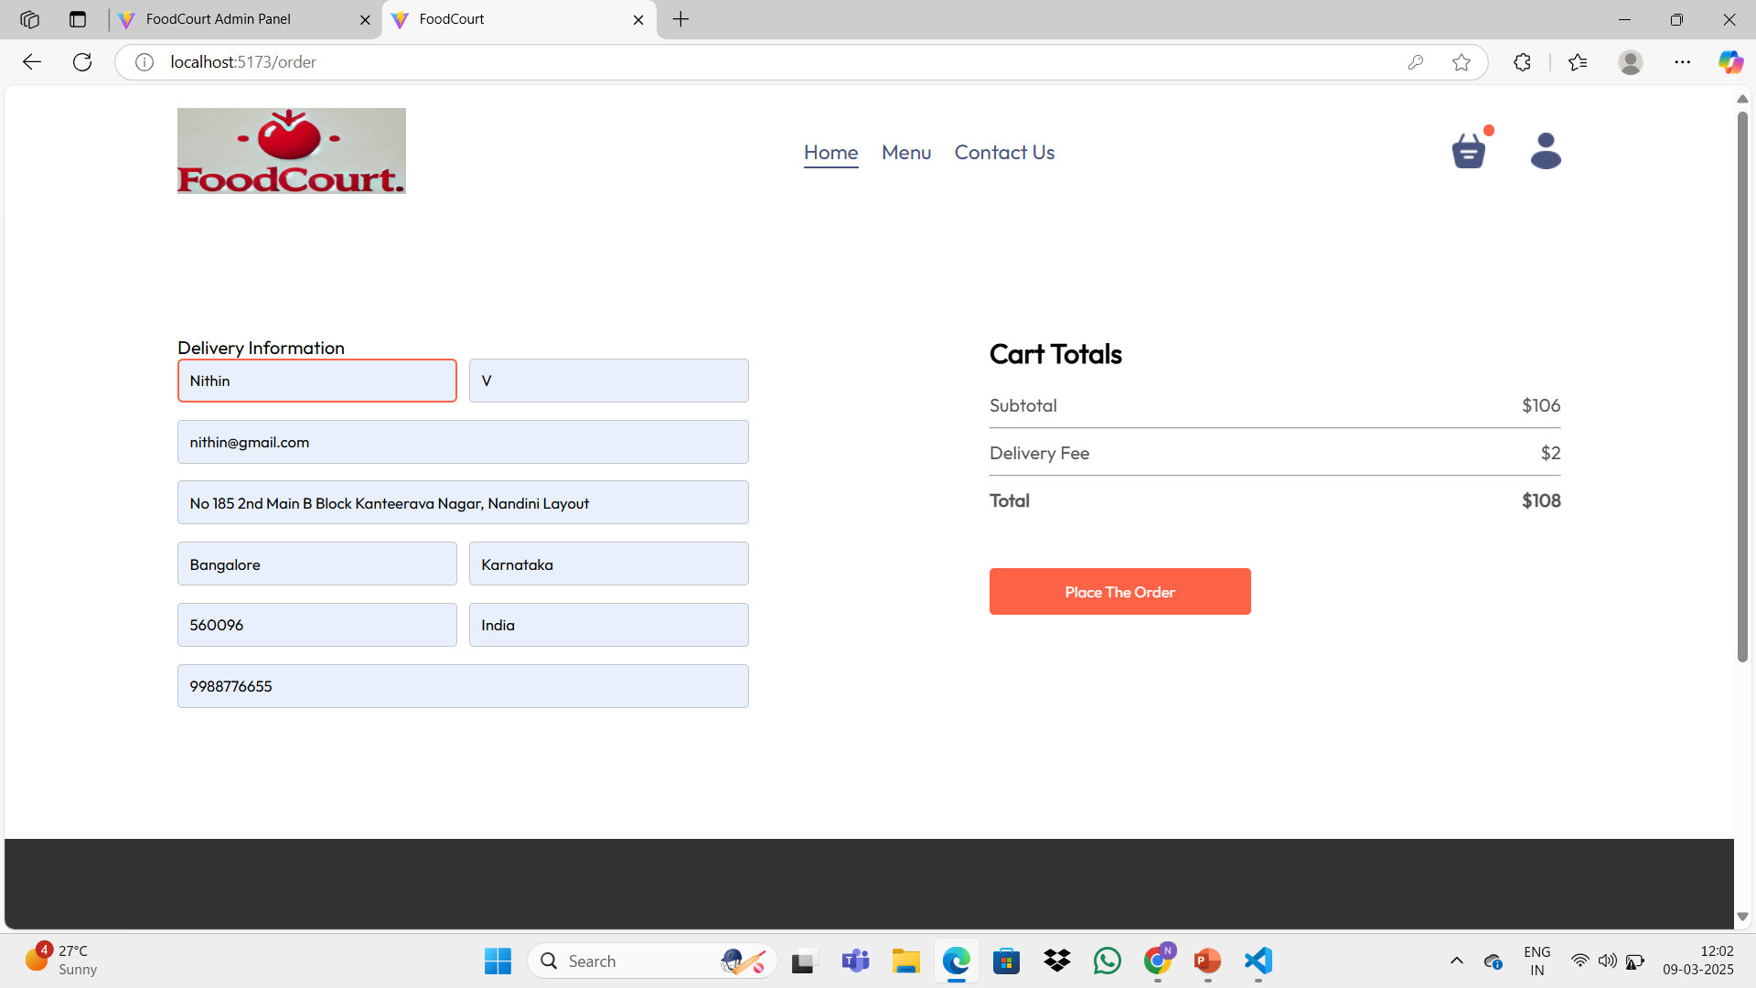
Modelling & Result

Slide 10
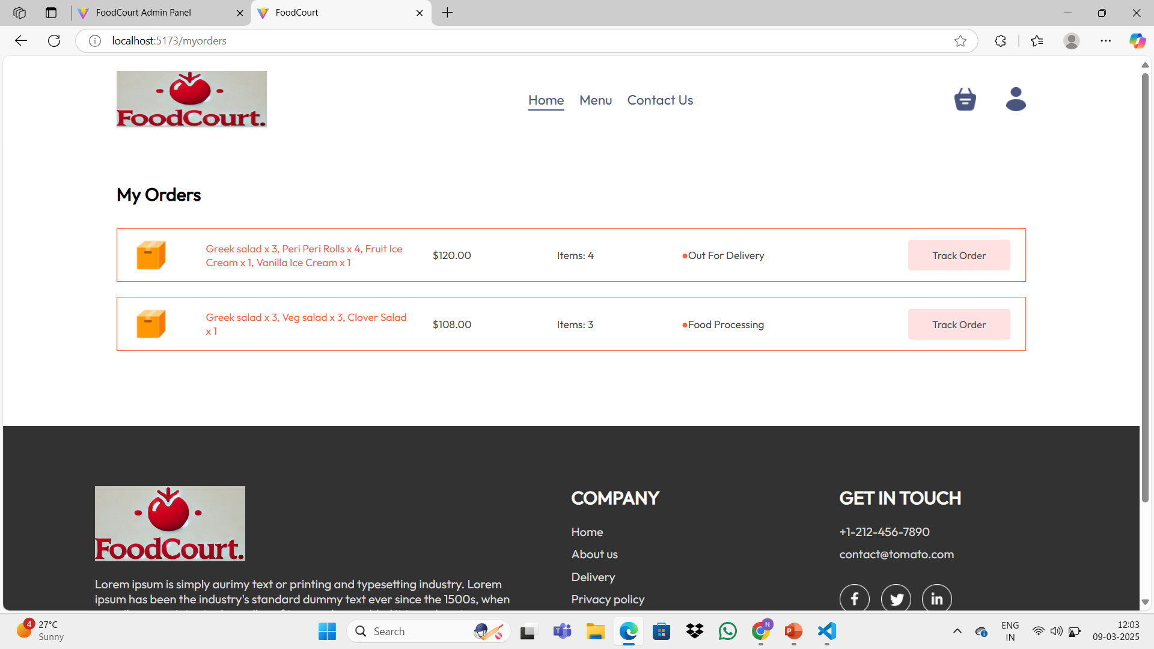
Modelling & Result

Slide 11

Conclusion
The project demonstrates a scalable, efficient, and modern food delivery system.
It enhances user experience, security, and business efficiency by integrating:
Real-time order tracking
Secure payments
A robust backend
Future Enhancements:
Mobile applications for better accessibility.
AI-powered chatbots for customer support.
Predictive analytics for demand forecasting.
Drone delivery systems for ultra-fast service.

Slide 12


Notes:
Thank You !!

